Slide 1

Business Problem:
You have been hired by a coal terminal to assess which of their coal reclaimer machines require maintenance in the upcoming month.
These machines run round the clock 24/7 for 365 days. Every minute of downtime equates to Millions of Dollars lost revenue, that is why it is crucial to identify exactly when these machines require maintenance.
Currently the coal terminal follows the following criteria: a reclaimer-type machine requires maintenance when within the previous month there was at least one 8-hour period when the average idle capacity was over 10%.
Idle capacity is a utilization metric which for the purposes of this project, is defined as
Idle capacity = (Actual Tonnage - Nominal Capacity) / Nominal Capacity
Your task is to find out which of the 5 machines have exceeded this level and create a report for the executive with your recommendations.
What we will learn today
Data Preparation (Pivot in Tableau)
Table Calculation
Running Total
Difference
First
Index
Lookup
Running Sum
Window Average
Window Count
Difference between Table Calculations and Calculated Field
If and Else Statements

Slide 2
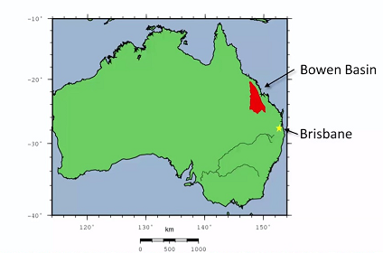
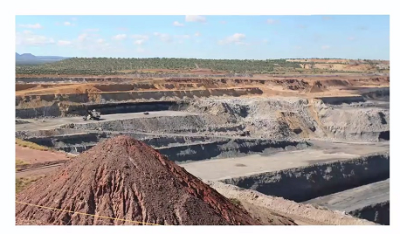
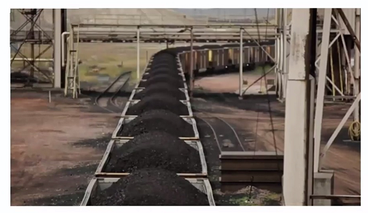
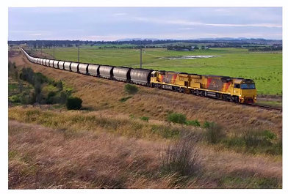
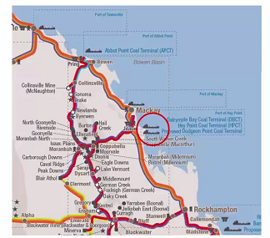
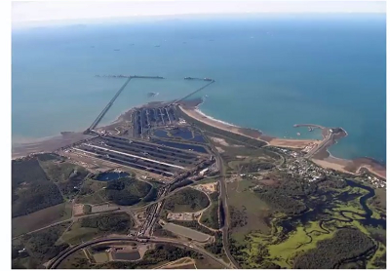
Coal Mine Case Study

Slide 3
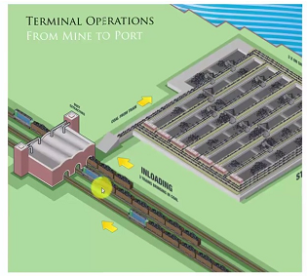
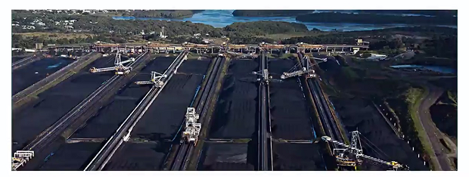
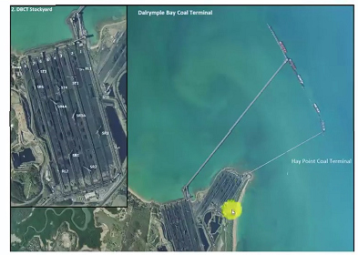
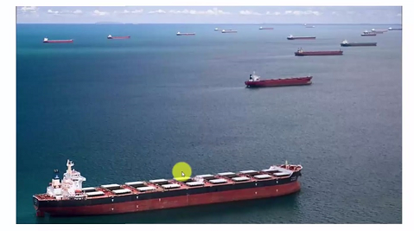

Slide 4
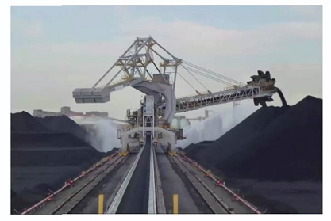
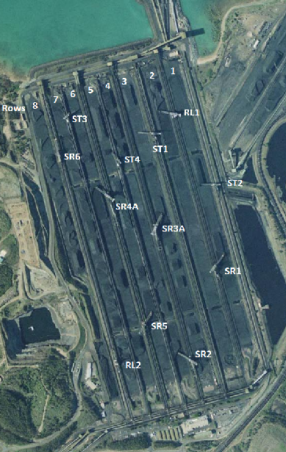
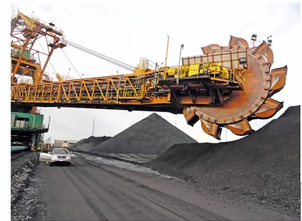
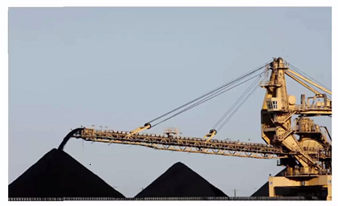

Slide 5
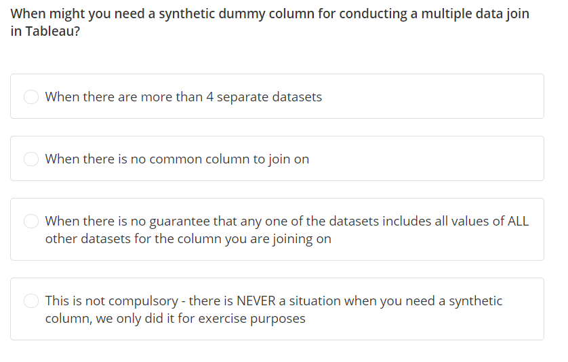

Slide 6
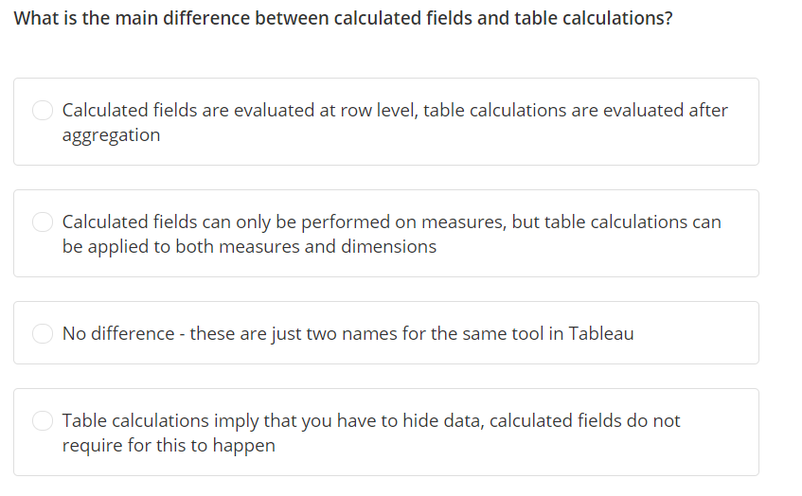

Slide 7
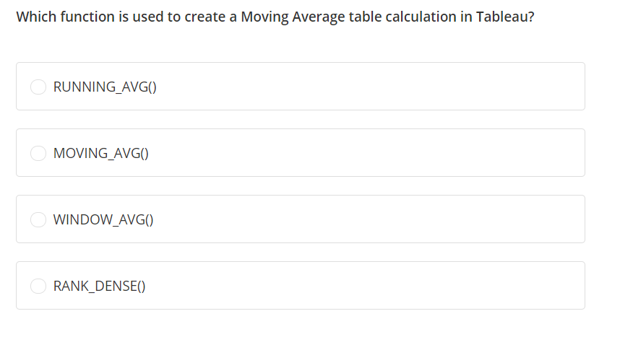

Slide 8
